Slide 1
CS 111 Operating Systems
Week 5
02/07/2020
Nikita Sivakumar*
* In collaboration with TA Shaan

Slide 2
Things we are going to discuss:
Overview of Project 2A:The Big Picture
Race Conditions
Critical Section
Atomic Operation
Locks
Synchronization
Course grained
Fine grained
Deadlocks
Code example

Slide 3
And as you know:
Project 2A
Spec: http://web.cs.ucla.edu/~harryxu/courses/111/winter20/ProjectGuide/P2A.html
Due on Wednesday (02/12/2020) at 11:59 PM
Late Policy : Exponential as discussed previously
Please remember to download your submissions and check if you submitted the correct files. Empty submissions - or submissions in the wrong format - cannot be graded and will therefore be scored with a 0

Slide 4
Race Conditions
A race condition occurs when two or more threads can access shared data and they try to change it at the same time. Because the thread scheduling algorithm can swap between threads at any time, you don't know the order in which the threads will attempt to access the shared data.
Therefore, the result of the change in data is dependent on the thread scheduling algorithm, i.e. both threads are "racing" to access/change the data.

Slide 5
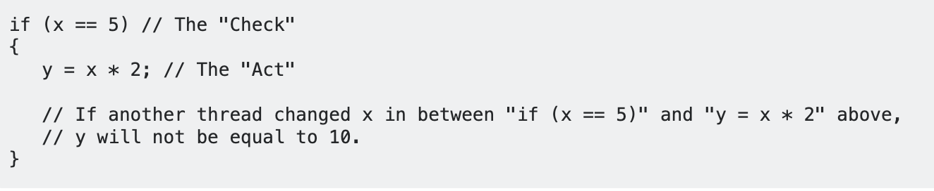
Race Conditions - An example problem
Problems often occur when one thread does a "check-then-act" (e.g. "check" if the value is X, then "act" to do something that depends on the value being X) and another thread does something to the value in between the "check" and the "act". E.g:
The point being, y could be 10, or it could be anything, depending on whether another thread changed x in between the check and act. You have no real way of knowing.

Slide 6
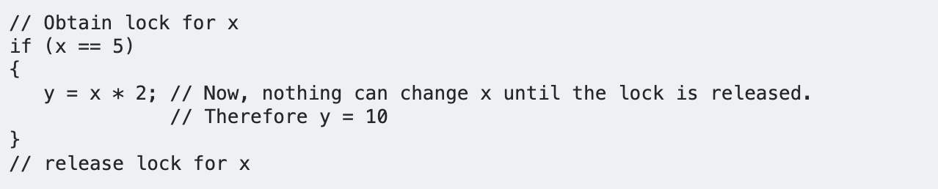
Race Condition - a solution
In order to prevent race conditions from occurring, you would typically put a lock around the shared data to ensure only one thread can access the data at a time. This would mean something like this:

Slide 7
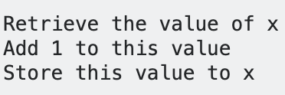
Race conditions in Project 2A
Imagine you had 5 threads executing this code : x = x+1 at once, the value of x would vary with each run.
This is because, in order for each thread to increment the value of x, they have to do the following: (simplified, obviously)

Slide 8
Race conditions in Project 2A - the problem
Any thread can be at any step in this process at any time, and they can step on each other when a shared resource is involved. The state of x can be changed by another thread during the time between x is being read and when it is written back.
Let's say a thread retrieves the value of x, but hasn't stored it yet. Another thread can also retrieve the same value of x (because no thread has changed it yet) and then they would both be storing the same value (x+1) back in x!

Slide 9
Ideal behavior vs Actual behavior
Ideal:
Thread 1: reads x, value is 0
Thread 1: add 1 to x, value is now 1
Thread 1: stores 1 in x
Thread 2: reads x, value is 1
Thread 2: adds 1 to x, value is now 2
Thread 2: stores 2 in x
Thread 3: reads x, value is 2
Thread 3: add 1 to x, value is now 3
Thread 3: stores 3 in x
Thread 4: reads x, value is 3
Thread 4: adds 1 to x, value is now 4
Thread 4: stores 4 in x
Actual:
Thread 1: reads x, value is 0
Thread 1: add 1 to x, value is now 1
Thread 2: reads x, value is 0
Thread 1: stores 1 in x
Thread 2: adds 1 to x, value is now 1
Thread 2: stores 1 in x
Thread 3: reads x, value is 1
Thread 3: add 1 to x, value is now 2
Thread 4: reads x, value is 1
Thread 3: stores 2 in x
Thread 4: adds 1 to x, value is now 2
Thread 4: stores 2 in x

Slide 10
Race conditions in Project 2A - a solution
This was an example of a multi-threaded race condition, and can be avoided by employing some sort of locking mechanism before the code that accesses the shared resource.
//lock x
x = x + 1;
//unlock x

Slide 11
A Multithreaded Race Condition
Imagine one thread whose job is to simply increment a counter and then decrement it...
0
1
0
+1
-1
void add(long long *pointer, long long value) {
long long sum = *pointer + value;
*pointer = sum;
}

Slide 12
A Multithreaded Race Condition
0
Load
0
+1
Store
1
Main
Memory
CPU Register
What actually happens? The variable is loaded into a CPU register, that register is updated, and then stored back.

Slide 13
A Multithreaded Race Condition
0
?
Load
Thread 1
Store
1
Load
0
Thread 2
Store
1
Main
Memory
What happens if: Thread 1 loads, then Thread 2 loads, then Thread 1 stores, then Thread 2 stores?

Slide 14
A Multithreaded Race Condition
0
1
Load
Thread 1
Store
1
Load
0
Thread 2
Store
1
Main
Memory
The variable would be at 1, even though two increments occurred!
What happens if: Thread 1 loads, then Thread 2 loads, then Thread 2 stores, then Thread 1 stores?

Slide 15
A Multithreaded Race Condition
0
1
Load
Thread 1
Store
1
Load
0
Thread 2
Store
1
Main
Memory
Again the variable would be at 1, even though two increments occurred!
What happens if: Thread 1 loads, then Thread 1 stores, then Thread 2 loads, then Thread 2 stores?

Slide 16
A Multithreaded Race Condition
0
2
Load
Thread 1
Store
1
Load
0
Thread 2
Store
1
Main
Memory
The variable would be 2, which is what we want! How can we guarantee this behavior?

Slide 17
A (un)Related Problem
Imagine that you and your friends are all trying to tell each other about how horrible the midterm was, but everyone is talking over each other since everyone wants to talk!
After being frustrated for a while, you pick up a stick on the ground and announce that this is the “talking stick.” Only someone holding the stick gets to talk; once they’re done talking, they may put down the stick for someone else to pick up.
Congrats, you’ve discovered synchronization!
Synchronization is a way to coordinate processes that use shared data

Slide 18
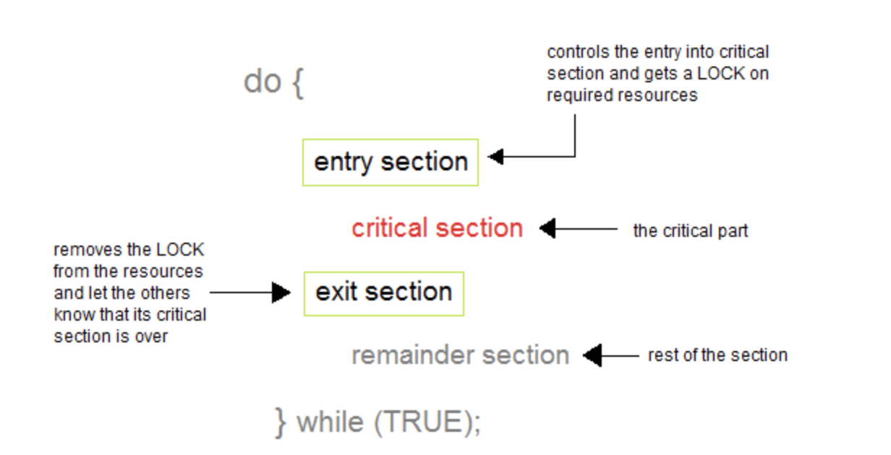
What is the critical section?
A Critical Section is a code segment that accesses shared variables and has to be executed as an atomic action. It means that in a group of cooperating processes, at a given point of time, only one process must be executing its critical section. If any other process also wants to execute its critical section, it must wait until the first one finishes.

Slide 19
What is an atomic operation?
Atomic operation are those operations that finish their tasks as a whole i.e. no other interruption is allowed before its completion while critical section is that part of the program which cannot be executed concurrently by more than one process.
We can indeed solve critical section problems using constraints of atomicity like disabling interrupts related to their shared data.

Slide 20
How Locks Solve Race Conditions
Locks are just the thread analog for talking sticks. When a thread wants to enter the critical section (a part of the code that has a race condition), it must claim ownership of the lock before entering. This means that only one thread is allowed at a time!
Once the critical section is complete, the thread must release the lock so that other threads may get a chance at performing work in the critical section too.
The act of making your code thread-safe (preventing race conditions from leaving your program in an invalid state) is called synchronization.

Slide 21
Synchronizing Add
This notation means the thread owns the lock
0
Load
0
0
0
1
Store
0
T1
T1
T1
1
1
1
Cannot Load since no lock
0
0
0
1
1
1
T2
T2
2
0
1
0
T1
T1
1
1
Store
Load
1
1
2
2
T2
T2

Slide 22
Coarse-Grained Synchronization
You might extend these ideas to more complicated settings. For instance suppose you have a linked list shared amongst multiple threads, and you want to avoid all race conditions.
What could be a race condition that occurs with linked lists?

Slide 23
Coarse-Grained Synchronization
A simple idea is force all threads to acquire a lock before using the linked list, and release it after the operation is complete.
T1 wants to append
T2 wants to delete
T1 wants to append
T2 wants to delete
T1 appended
T2 wants to delete

Slide 24
Coarse-Grained Synchronization
This notation means the thread owns the lock
1
2
3
4
1
2
3
4
5
1
2
3
4
T1 wants to append
T2 wants to delete 2nd to last
T1 appended
T2 wants to delete 2nd to last
T1 wants to append 5
T2 wants to remove 2nd to last
1
2
3
5
1
2
3
4
5
1
2
3
4
5
T1 done
T2 deleted
T1 done
T2 wants to delete 2nd to last
T1 appended, lock released
T2 wants to delete 2nd to last

Slide 25
Fine Grained Synchronization
Though coarse-grained synchronization is easier to verify correctness, it is slower because only one thread accesses the data structure at a time even though different threads may not actually interfere with each other.
1
7
19
29
3
7
19
23
29
Thread 1 wants to change 1 to a 3, and Thread 2 wants to insert 23 before 29. They seem to not really interfere with each other. Can we create a synchronization mechanism that captures this idea and allows a more efficient synchronization?

Slide 26
Fine Grained Synchronization
The intuition is that we don’t need to synchronize access to the entire linked list, but need to synchronize access to a smaller unit of the linked list-- the nodes.
If a thread wants to modify a linked list, then they want to modify a few nodes (e.g. inserting requires accessing two nodes to switch pointers around). If two threads want to modify separate nodes on the list, they should be able to do so. So let’s give every node a lock.
1
7
19
29
3
7
19
23
29

Slide 27
Deadlocks
Imagine Thread 1 wants to insert a node in front of 1, and Thread 2 wants to insert a node behind 7. Thread 1 needs to modify the “previous” pointer of 7, and Thread 2 needs to modify the “next” pointer of 1. Each node has a corresponding lock to access that node.
1
7
What happens if Thread 1 gets 1’s lock, and then Thread 2 gets 2’s lock?

Slide 28
Deadlocks
Suppose Thread 1 gets 1’s lock, and then Thread 2 gets 2’s lock. Because Thread 1 wants to change 7’s previous pointer, it needs 7’s lock too. Because Thread 2 wants to change 1’s next pointer, it needs 1’s lock too. Each thread waits for the other to release their lock, and both threads halt.
1
7
When two threads wait for each other to release locks, we call this a deadlock.

Slide 29
Ways to Avoid Deadlocks
Some simple ways to avoid deadlocks when your program has multiple locks:
Have a global lock that every thread needs to acquire before trying to acquire other locks. (Synchronizing lock acquisition)
Establish a partial ordering of your locks (some locks come before others). For example you might insist that threads acquire the locks of a linked list from left to right.
1
7
If we force the threads to acquire locks from left-to-right, then Thread 2 cannot own 7’s lock before it owns 1’s lock.

Slide 30
Different Synchronization Primitives
There are various synchronization primitives, each with performance tradeoffs:
Spin Locks - This lock works by having a boolean flag where we loop if it is false and “acquire” it by setting the flag to true. The read/write operation must be atomic. Why?
Mutex - This lock tends to involve OS system calls that force a thread to go to sleep if the lock is being used, woken up by the OS if the lock becomes available.
Atomic Compare-and-Swap - This allows us to atomically change the value of a variable if it is currently equal to some value. For example if a boolean flag is currently false, we will swap its value with true. This can be used to implement spin locks as well.
Atomic Test-and-set - Atomically (“instantly”) tests if the lock holds 0, and sets it to 1. This can be used to implement spin locks as well (where the variable is boolean flag to see if the lock is acquired)

Slide 31
Let’s look at some code

Slide 32
#include <pthread.h>
#include <stdio.h>
#include <stdlib.h>
#include <string.h>
#include <unistd.h>
pthread_t tid[2]; int counter;
void* trythis(void* arg) {
unsigned long i = 0;
counter += 1;
printf("\n Job %d has started\n", counter);
for (i = 0; i < (0xFFFFFFFF); i++) ;
printf("\n Job %d has finished\n", counter);
return NULL;
}
int main(void) {
int i = 0;
int error;
while (i < 2) {
error = pthread_create(&(tid[i]), NULL, &trythis, NULL);
if (error != 0)
printf("\nThread can't be created : [%s]", strerror(error));
i++;
}
pthread_join(tid[0], NULL);
pthread_join(tid[1], NULL);
return 0;
}

Slide 33
What could be the output?

Slide 34
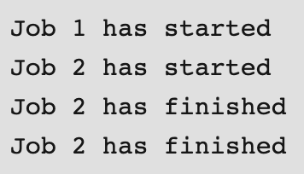
Output:

Slide 35
Why this is occurring
On observing closely and visualizing the execution of the code, we can see that :
The log ‘Job 2 has started’ is printed just after ‘Job 1 has Started’ so it can easily be concluded that while thread 1 was processing the scheduler scheduled the thread 2.
If we take the above assumption, then the value of the ‘counter’ variable got incremented again before job 1 got finished.
So, when Job 1 actually got finished, then the wrong value of counter produced the log ‘Job 2 has finished’ followed by the ‘Job 2 has finished’ for the actual job 2 or vice versa as it is dependent on scheduler.
So we see that it’s not the repetitive log but the wrong value of the ‘counter’ variable that is the problem.
The actual problem was the usage of the variable ‘counter’ by a second thread when the first thread was using or about to use it.
In other words, we can say that Synchronization problem between the threads while using the shared resource ‘counter’ caused the problems

Slide 36
Problem
From the last two logs, one can see that the log ‘Job 2 has finished’ is repeated twice while no log for ‘Job 1 has finished’ is seen.
Why is this occurring?

Slide 37
Based on today’s discussion, how can we solve this?

Slide 38
One kind of lock: Mutex Lock
A Mutex is a lock that we set before using a shared resource and release after using it.
When the lock is set, no other thread can access the locked region of code.
So we see that even if thread 2 is scheduled while thread 1 was not done accessing the shared resource and the code is locked by thread 1 using mutexes then thread 2 cannot even access that region of code.
So this ensures synchronized access of shared resources in the code

Slide 39
Let’s look at some lock-based code

Slide 40
#include <pthread.h>
#include <stdio.h>
#include <stdlib.h> #include <string.h> #include <unistd.h>
pthread_t tid[2]; int counter;
void* trythis(void* arg) {
pthread_mutex_lock(&lock);
unsigned long i = 0;
counter += 1;
printf("\n Job %d has started\n", counter);
for (i = 0; i < (0xFFFFFFFF); i++) ;
printf("\n Job %d has finished\n", counter);
pthread_mutex_unlock(&lock);
return NULL;
}
int main(void) {
int i = 0;
int error;
if (pthread_mutex_init(&lock, NULL) != 0) {
printf("\n mutex init has failed\n");
return 1;
}
while (i < 2) {
error = pthread_create(&(tid[i]),
NULL,
&trythis, NULL);
if (error != 0)
printf("\nThread can't be created :[%s]",
strerror(error));
i++;
}
pthread_join(tid[0], NULL);
pthread_join(tid[1], NULL);
pthread_mutex_destroy(&lock);
return 0;
}

Slide 41
What is happening?
In the above code:
A mutex is initialized in the beginning of the main function.
The same mutex is locked in the ‘trythis()’ function while using the shared resource ‘counter’.
At the end of the function ‘trythis()’ the same mutex is unlocked.
At the end of the main function when both the threads are done, the mutex is destroyed.

Slide 42
What could be the output?

Slide 43
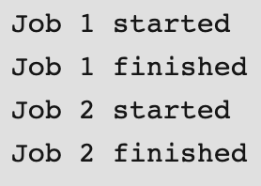
Output:

Slide 44
So, how did the code achieve this?

Slide 45
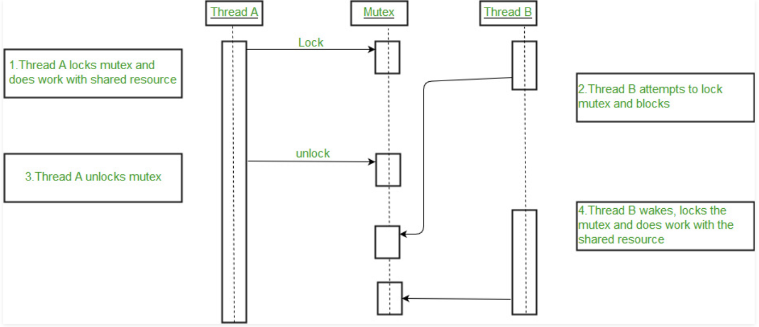
Big Picture

Slide 46
Detailed insight into the functions
int pthread_mutex_init(pthread_mutex_t *restrict mutex, const pthread_mutexattr_t *restrict attr)
Creates a mutex, referenced by mutex, with attributes specified by attr.
Returned value
If successful, pthread_mutex_init() returns 0, and the state of the mutex becomes initialized and unlocked.
If unsuccessful, pthread_mutex_init() returns -1.
int pthread_mutex_destroy(pthread_mutex_t *mutex)
Deletes a mutex object, which identifies a mutex. Mutexes are used to protect shared resources. mutex is set to an invalid value, but can be reinitialized using pthread_mutex_init().
Returned value
If successful, pthread_mutex_destroy() returns 0.
If unsuccessful, pthread_mutex_destroy() returns -1

Slide 47
Detailed insight into the functions
int pthread_mutex_lock(pthread_mutex_t *mutex)
Locks a mutex object, which identifies a mutex. If the mutex is already locked by another thread, the thread waits/is blocked until the mutex to become available. The thread that has locked a mutex becomes its current owner and remains the owner until the same thread has unlocked it. When this kind of mutex is locked multiple times by the same thread, then a count is incremented and no waiting thread is posted. The owning thread must call pthread_mutex_unlock() the same number of times to decrement the count to zero.
Returned value
If successful, pthread_mutex_lock() returns 0.
If unsuccessful, pthread_mutex_lock() returns -1.
int pthread_mutex_unlock(pthread_mutex_t *mutex)
Releases a mutex object. If one or more threads are waiting to lock the mutex, pthread_mutex_unlock() causes one of those threads to return from pthread_mutex_lock() with the mutex object acquired. If no threads are waiting for the mutex, the mutex unlocks with no current owner. When this kind of mutex is locked multiple times by the same thread, then unlock will decrement the count and no waiting thread is posted to continue running with the lock. If the count is decremented to zero, then the mutex is released and if any thread is waiting for it is posted.
Returned value
If successful, pthread_mutex_unlock() returns 0.
If unsuccessful, pthread_mutex_unlock() returns -1

Slide 48
Thank you

